Slide 1
Motivation Slides
Chinook for Networking Task Force (Dell, HPE, Intel, Microsoft, Vmware)

Slide 2
Network Management Focus Areas
Complex and disparate toolsets, protocols and systems
Resource intensive and time consuming
Proprietary vendor implementations
Poor portability of skillsets across compute, storage and networking
Lack of interoperability with rest of infrastructure

Slide 3
Solution
Expose IETF YANG Models within Redfish
Why YANG?
Large body of existing work
Extensive coverage from multiple SDOs (IETF, IEEE, OCP, OpenConfig, ODL) as well as many vendor proprietary models
Many man-years of work by industry experts across all networking feature sets
Basis for general network industry manageability
IETF & IEEE are the primary standards bodies
IETF – Yang is the standard for all new network management modeling
IEEE – Adopted Yang as modeling language
Other consortiums and bodies have also adopted Yang for network models
Model driven approach to network management
DMTF wants to leverage the networking industry's expertise

Slide 4
Why Redfish for Networking
Completes the converged infrastructure management API story
Switches have platform components in common with servers and storage
Rapid expansion of open Network Operating System (NOS) solutions
Network Functions Virtualization (NFV) will need common manageability for compute and networking
Enable common inventory and control for orchestration systems
Redfish provides a prescriptive model for the system/platform management
Allows partnership with IETF
Specify a prescriptive baseline of YANG models for networking
Reduce overlap and clarify manageability domains

Slide 5
Redfish Extensions for Networking (Being submitted)
Motivation Slide
YANG-to-CSDL Mapping specification
Specifies mapping of YANG structures to CSDL structures
CSDL Term library (RedfishYangExtensions.xml)
Examples of translated RFCs (mockups and CSDL)
Interfaces
Simple services
DHCP

Slide 6
Backup

Slide 7
YANG to CSDL
mockup
& schema
Manually
(3 RFCs)
YANG
RFC
Redfish
Complete
CSDL
YANG
Complete
CSDL
YANG to CSDL
Mapping
Spec
Converter
program

Slide 8
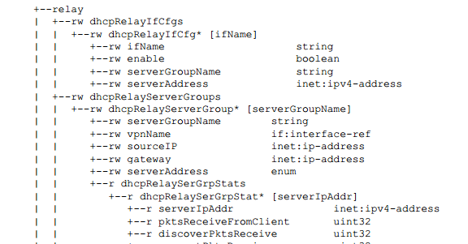
YANG model mapping
Goal
Manual create example of Redfish model constructed by a programmatic generator using RFCs as input
YANG models
Took a sample of three YANG models that span the breadth of YANG statement types
Use draft-liu-dhc-dhcp-yang-model-00
<List other YANG models)
Purpose
Understand YANG statement and resultant CSDL
Limitations and conflicts (naming, etc)
draft-liu-dhc-dhcp-yang-model-00.pdf

